Slide 1
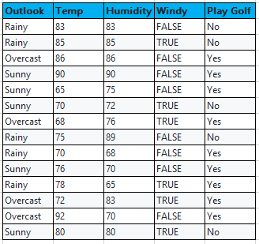
Input Attributes
(Categorical)
Target value
(Real Number)

Slide 2
Find “Entropy” of Target Variable
Find “Information Gain” and “Split Info” of Each Input Attribute
Find “Gain Ratio” of Each Input Attribute
Consider Input Attribute with Highest “Gain Ratio” as Root Element
Divide the dataset into Sub-Branches(Sub-Partitions)
IF Entropy = 0
Leaf Node
Yes
No

Slide 3
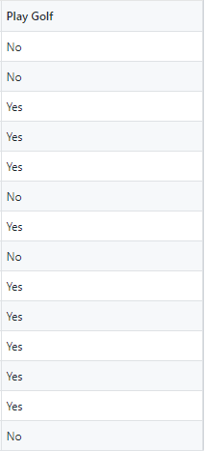



Target Variable:
Entropy Formula:
Target Samples:
Finding Entropy of System:

Slide 4

Information Gain Ratio :
Gain (A)
Gain Ratio (A) =
Split Info (A)
Information Gain Formula:
Split Info Formula:
Note: Here x refer to each category in input Attribute (A)

Slide 5
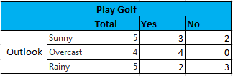

Find Gain Ratio (Outlook):
E(Play Golf, Outlook) = P(Sunny)*E(3, 2) + P(Overcast)*E(4, 0) + P(Rainy)*E(2, 3)
= (5/14) * 0.971 + (4/14) * 0.0 + (5/14) * 0.971
= 0.346 + 0 + 0.346
= 0.693
Split Info (Outlook) = - P(sunny) . log₂(P(Sunny)) - P(Overcast) . log₂(P(Overcast)) - P(Rainy) . log₂(P(Rainy))
= - (5/14) * log₂ (5/14) – (4/14) * log₂ (4/14) – (5/14) log₂(5/14)
= 1.577
Gain (A)
Gain Ratio (A) =
= 0.257 / 1.577 = 1.55
Split Info (A)

Slide 6


Find Gain Ratio (Windy):
E(Hours, Temp) = P(True)*E(3, 3) + P(False)*E(6, 2)
= (6/14) * 0.1 + (8/14) * 0.4636
= 0.428 + 0.464
= 0.892
Split Info (Temp) = - P(True) . log₂(P(True)) - P(False) . log₂(P(False))
= - (6/14) * log₂ (6/14) – (8/14) * log₂ (8/14)
= 0.523 + 0.461
= 0.985
Gain (A)
Gain Ratio (A) =
= 0.048 / 0.985 = 0.048
Split Info (A)

Slide 7
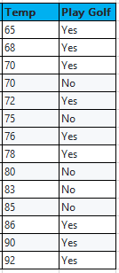
Find Gain Ratio (Temp):
Entropy (PG | Temp <= 65) = -P(No) * log₂ (No) –P(Yes) * log₂ (Yes)
= -(0/1)* log₂(0/1) - (1/1) * log₂(1/1)
= 0 ie: if all the values belongs to same class then entropy will be Zero.
Entropy (PG | Temp > 65) = -(5/13).log₂(5/13) – (8/13).log₂(8/13)
= 0.530 + 0.431
= 0.961
Gain(PG | Temp <> 65) = 0.94 – (1/14) * 0 – (13/14) * 0.961
= 0.048
Split Info(PG | Temp <> 65) = – (1/14) * log₂ (1/14) – (13/14) * log₂ (13/14)
= 0.371
Gain Ratio (PG | Temp <> 65) = 0.128
Note: We have to find the same for all the remaining Values in the Attribute

Slide 8
Find Gain Ratio (Temp): Cont..
Gain Ratio (PG | Temp <> 68) = 0.169
Gain Ratio (PG | Temp <> 86) = 0.169
Gain Ratio (PG | Temp <> 70) = 0.016
Gain Ratio (PG | Temp <> 90) = 0.127
Gain Ratio (PG | Temp <> 72) = 0.047
Note: 92 we are not going to consider since it is the Threshold limit
Gain Ratio (PG | Temp <> 75) = 0.001
Gain Ratio (PG | Temp <> 76) = 0.015
Gain Ratio (PG | Temp <> 78) = 0.048
Gain Ratio (PG | Temp <> 80) = 0.003
Gain Ratio (PG | Temp <> 83) = 0.016
Gain Ratio (PG | Temp <> 85) = 0.212

Slide 9
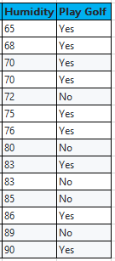
Find Gain Ratio (Humidity):
Entropy (PG | Humidity <= 65) = -P(No) * log₂ (No) –P(Yes) * log₂ (Yes)
= -(0/1)* log₂(0/1) - (1/1) * log₂(1/1)
= 0
ie: if all the values belongs to same class then entropy will be Zero.
Entropy (PG | Humidity > 65) = -(5/13).log₂(5/13) – (8/13).log₂(8/13)
= 0.530 + 0.431
= 0.961
Gain(PG | Humidity <> 65) = 0.94 – (1/14) * 0 – (13/14) * 0.961
= 0.048
Split Info(PG | Humidity <> 65) = – (1/14) * log₂ (1/14) – (13/14) * log₂ (13/14)
= 0.371
Gain Ratio (PG | Humidity <> 65) = 0.128
Note: We have to find the same for all the remaining Values in the Attribute

Slide 10
Find Gain Ratio (Humidity): Cont..
Gain Ratio (PG | Humidity <> 68) = 0.169
Gain Ratio (PG | Humidity <> 86) = 0.169
Gain Ratio (PG | Humidity <> 70) = 0.261
Gain Ratio (PG | Humidity <> 90) = 0.127
Gain Ratio (PG | Humidity <> 72) = 0.047
Note: 90 we are not going to consider since it is the Threshold limit
Gain Ratio (PG | Humidity <> 75) = 0.091
Gain Ratio (PG | Humidity <> 76) = 0.151
Gain Ratio (PG | Humidity <> 78) = 0.048
Gain Ratio (PG | Humidity <> 80) = 0.108
Gain Ratio (PG | Humidity <> 83) = 0.028
Gain Ratio (PG | Humidity <> 85) = 0.002

Slide 11
Outlook | Temp | Humidity | Windy | Play Golf
Overcast | 86 | 86 | FALSE | Yes
Overcast | 68 | 76 | TRUE | Yes
Overcast | 72 | 83 | TRUE | Yes
Overcast | 92 | 70 | FALSE | Yes
Group – 1
Rainy | 83 | 83 | FALSE | No
Rainy | 85 | 85 | TRUE | No
Rainy | 75 | 89 | FALSE | No
Rainy | 70 | 68 | FALSE | Yes
Rainy | 78 | 65 | TRUE | Yes
Group – 2
Sunny | 90 | 90 | FALSE | Yes
Sunny | 65 | 75 | FALSE | Yes
Sunny | 70 | 72 | TRUE | No
Sunny | 76 | 70 | FALSE | Yes
Sunny | 80 | 80 | TRUE | No
Group – 3

Slide 12
Outlook
Root Node
Sub-Partition
Sunny
Overcast
Rainy
Yes
Windy
Humidity
FALSE
TRUE
>80
<= 80
Yes
No
No
Yes
Leaf Node

